Slide 1
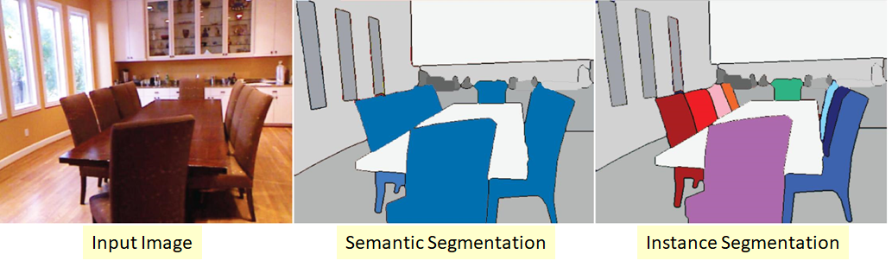
By:
DEEPALI

Slide 2
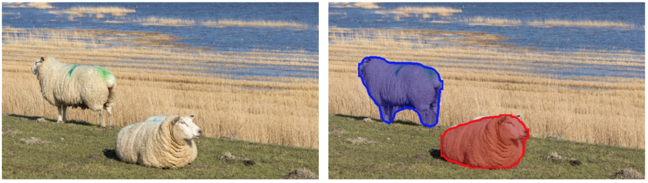
What is Image Segmentation?
the term “image segmentation” or simply “segmentation” means dividing the image into groups of pixels based on some criteria. You can do this grouping based on color, texture, or some other criteria that you have decided. These groups are sometimes also called super-pixels.
What is instance segmentation?
In instance segmentation the goal is to detect specific objects in an image and create a mask around the object of interest. Instance segmentation can also be thought as object detection where the output is a mask instead of just a bounding box. Unlike semantic segmentation, which tries to categorize each pixel in the image, instance segmentation does not aim to label every pixel in the image.

Slide 3
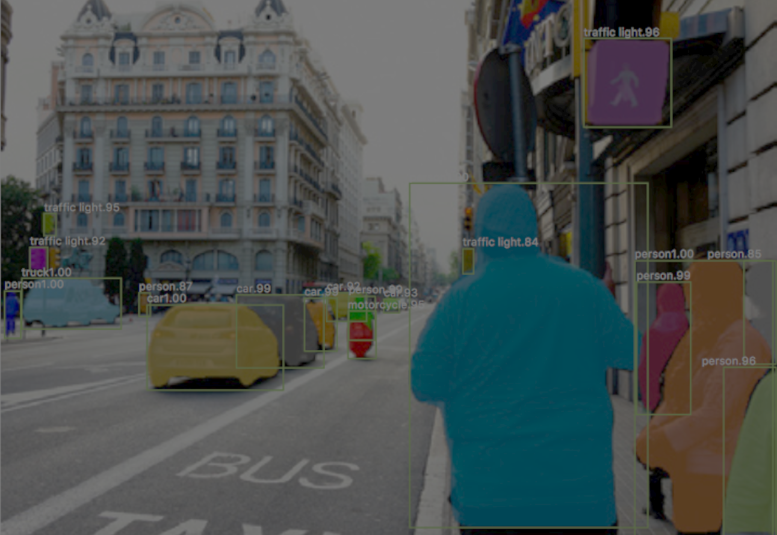
DEEPMASK

Slide 4
DEEPMASK
DeepMask, by Facebook AI Research (FAIR), is reviewed. Starting from AlexNet, high accuracy is obtained by convolutional neural network (CNN) for image classification, numerous CNN approaches are developed for other tasks such as object detection, semantic segmentation, and instance segmentation. DeepMask is the CNN approach for instance segmentation.
DeepMask Proposals
Our object proposal method predicts a segmentation mask given an input patch, and assigns a score corresponding to how likely the patch is to contain an object. Both mask and score predictions are achieved with a single convolutional network. ConvNets are flexible models which can be applied to various computer vision tasks and they alleviate the need for manually designed features. Their flexible nature allows us to design a model in which the two tasks (mask and score predictions) can share most of the layers of the network. Only the last layers are task-specific (see Figure 1). During training, the two tasks are learned jointly. Compared to a model which would have two distinct networks for the two tasks, this architecture choice reduces the capacity of the model and increases the speed of full scene inference at test time.

Slide 5

What is COCO?
COCO is defined as Common Objects in Context Dataset Mirror
COCO is a large image dataset designed for object detection, segmentation, person keypoints detection, stuff segmentation, and caption generation. The COCO dataset is an excellent object detection dataset with 80 classes, 80,000 training images and 40,000 validation images. COCO has several features:
Object segmentation
Recognition in context
Superpixel stuff segmentation
330K images (>200K labeled)
1.5 million object instances
80 object categories
91 stuff categories
5 captions per image
250,000 people with keypoints

Slide 6
Vgg16
VGG16 (also called OxfordNet) is a convolutional neural network architecture named after the Visual Geometry Group from Oxford, who developed it. It was used to win the ILSVR (ImageNet) competition in 2014. To this day is it still considered to be an excellent vision model, although it has been somewhat outperformed by more revent advances such as Inception and ResNet.
Application:
Given image → find object name in the image
It can detect any one of 1000 images
It takes input image of size 224 * 224 * 3 (RGB image)
Built using:
Convolutions layers (used only 3*3 size )
Max pooling layers (used only 2*2 size)
Fully connected layers at end
Total 16 layers

Slide 7
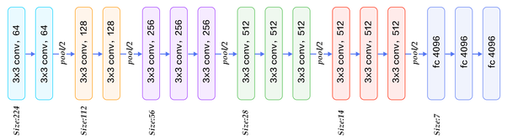
Description of layers:
Convolution using 64 filters
Convolution using 64 filters + Max pooling
Convolution using 128 filters
Convolution using 128 filters + Max pooling
Convolution using 256 filters
Convolution using 256 filters
Convolution using 256 filters + Max pooling
Convolution using 512 filters
9. Convolution using 512 filters
10. Convolution using 512 filters + Max pooling
11. Convolution using 512 filters
12. Convolution using 512 filters
13. Convolution using 512 filters + Max pooling
14. Fully connected with 4096 nodes
15. Fully connected with 4096 nodes
16. Output layer with Softmax activation with 1000 nodes.

Slide 8
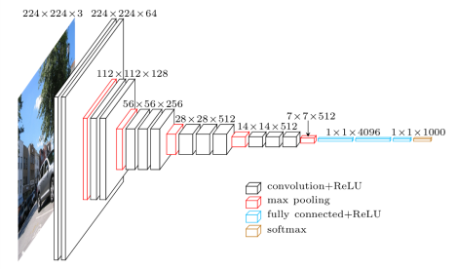
Full view at image level:

Slide 9
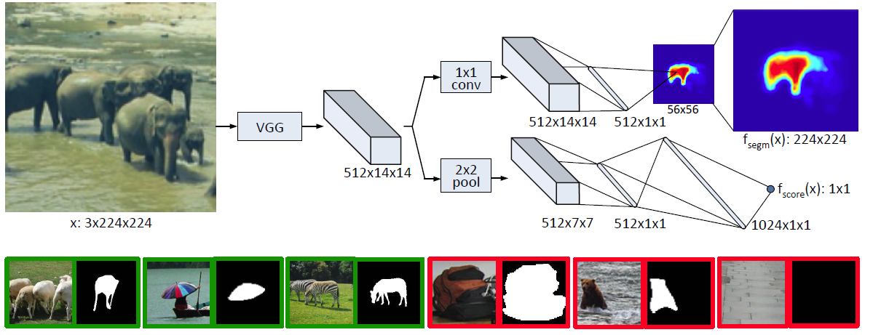
Model Architecture

Slide 10
Left Bottom: Positive Samples
A label yk=1 is given for k-th positive sample. To be a positive sample, two criteria need to be satisfied:
The patch contains an object roughly centered in the input patch.
The object is fully contained in the patch and in a given scale range.
When yk=1, the ground truth mask mk has positive values for the pixels which belong to the single object located in the centre of the image patch.
Right Bottom: Negative Samples
Otherwise, a label yk=-1 is given for a negative sample even the object is partially present. When yk=-1, the mask is not used.
Top, Model Architecture: Main Branch
The model as shown above, given the input image patch x, after feature extraction by VGGNet, The fully connected (FC) layers originated in VGGNet are removed. The last max pooling layer in VGGNet is also removed, thus the output before splitting into two paths are of the size of 1/16 of input. For example as above, the input is 224×224 (3 is the number of channels in the input image, i.e. RGB), the output at the end of main branch is (224/16)×(224/16) =14×14. (512 is the number of feature maps after convolution.)

Slide 11
The first path is to predict the class-agnostic segmentation mask, i.e. fsegm(x).
The second path is to assign a score corresponding to how likely the patch is to contain an object, i.e. fscore(x).
Top, First Path: Predicting Segmentation Map
1×1 convolution is performed first without changing the number of feature maps, non-linear mapping without dimension reduction is done here. After that, two FC layers are performed. (It is notice that there is no ReLU in between these two FC layers!)
Unlike in semantic segmentation, the network must output a mask for a single object even when multiple objects are present. (Just like the elephant in the centre of the input image as shown above.)
Finally, a 56×56 segmentation map is generated. And a simple bilinear interpolation is to upsample the segmentation map to 224×224.
Top, Second Path: Predicting Object Score
2×2 max pooling followed by two FC layers. Finally, one single value Predicted Object Score, fscore(x), is obtained. Since positive samples are given based on the two criteria mentioned above, fscore(x) is to predict whether the input image has satisfied these two criteria.

Slide 12
Joint Learning
i) Loss Function
The network is trained to jointly learn the pixel-wise segmentation map fsegm(xk) at each location (i,j) and the predicted object score fscore(xk). The loss function is shown as below:
To be brief, the loss function is a sum of binary logistic regression losses, one for each location of the segmentation network fsegm(xk) and one for the object score fscore(xk). The first term implies that we only backpropagate the error over the segmentation path if yk=1.
If yk=-1, i.e. the negative sample, the first term become 0 and will not contribute to the loss. Only the second term contributes the loss.
For the sake of data balance, equal number of positive and negative samples is used.
ii) Other Details
Batch size of 32 is used. Pretrained ImageNet model is used. There are 75M parameters in total.

Slide 13
Full Scene Inference
Multiple Locations and Scales
During testing, the model is applied densely at multiple locations with a stride of 16 pixels, and multiple scales from 1/4 to 2 with a step size of square root of 2. This ensures that there is at least one tested image patch that fully contains each object in the image.
Fine Stride Max Pooling
Since the input test image is larger than the training input patch size, we need a corresponding 2D scoring map as an output rather than one single scoring value. An interleaving trick is used before the last max pooling layer for the scoring branch, i.e. the Fine Stride Max Pooling proposed in OverFeat.
To be brief, multiple max pooling is done on the feature map. A pixel shift is performed before each max pooling.

Slide 14
Results
MS COCO (Boxes & Segmentation Masks)
80,000 images and a total of nearly 500,000 segmented objects, are used for training. And the first 5000 images of the MS COCO 2014 are used for validated.
DeepMask20: Trained only with objects belonging to one of the 20 PASCAL categories. AR is low compared to DeepMask which means the network is not generalized to unseen classes. (low scores for unseen classes.)
DeepMask20*: Similar to DeepMask but the scoring path uses the original DeepMask.
DeepMaskZoom: Additional smaller scale to boost AR but with the cost of increased inference time.
DeepMaskFull: The two FC layers at the path for predicting the segmentation mask are replaced by one FC layer directly mapped from the 512×14×14 feature maps to the 56×56 segmentation maps. The whole architecture are with over 300M parameters. It is slightly inferior to DeepMask and much slower.

Slide 15
PASCAL VOC 2007 (Boxes)
Region proposals are generated based on the predicted segmentation masks, which can be used as the first step of object detection task.
Fast R-CNN using DeepMask outperforms original Fast R-CNN using Selective Search as well as other state-of-the-art approaches.
Inference Time
The inference time in MS COCO is 1.6s per image.
The inference time in PASCAL VOC 2007 is 1.2s per image.
Inference time can be further dropped by about 30% by parallelizing all scales in a single batch.

Slide 16
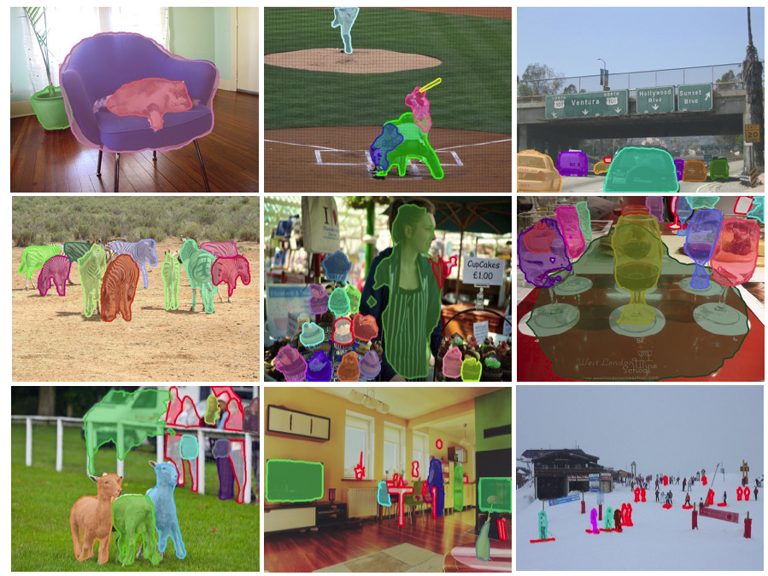
Qualitative Results
DeepMask proposals with highest IoU to the ground truth on selected images from COCO. Missed objects (no matching proposals with IoU > 0.5) are marked with a red outline.

Slide 17
THANK YOU

